Slide 1


BIO Grains Trading AG
Your Trusted Partner for Organic Commodities
Bio Suisse • EU Organic • GMP+ FRA/FSA
Buochserstrasse 26b • CH-6375 Beckenried • Switzerland

Slide 2
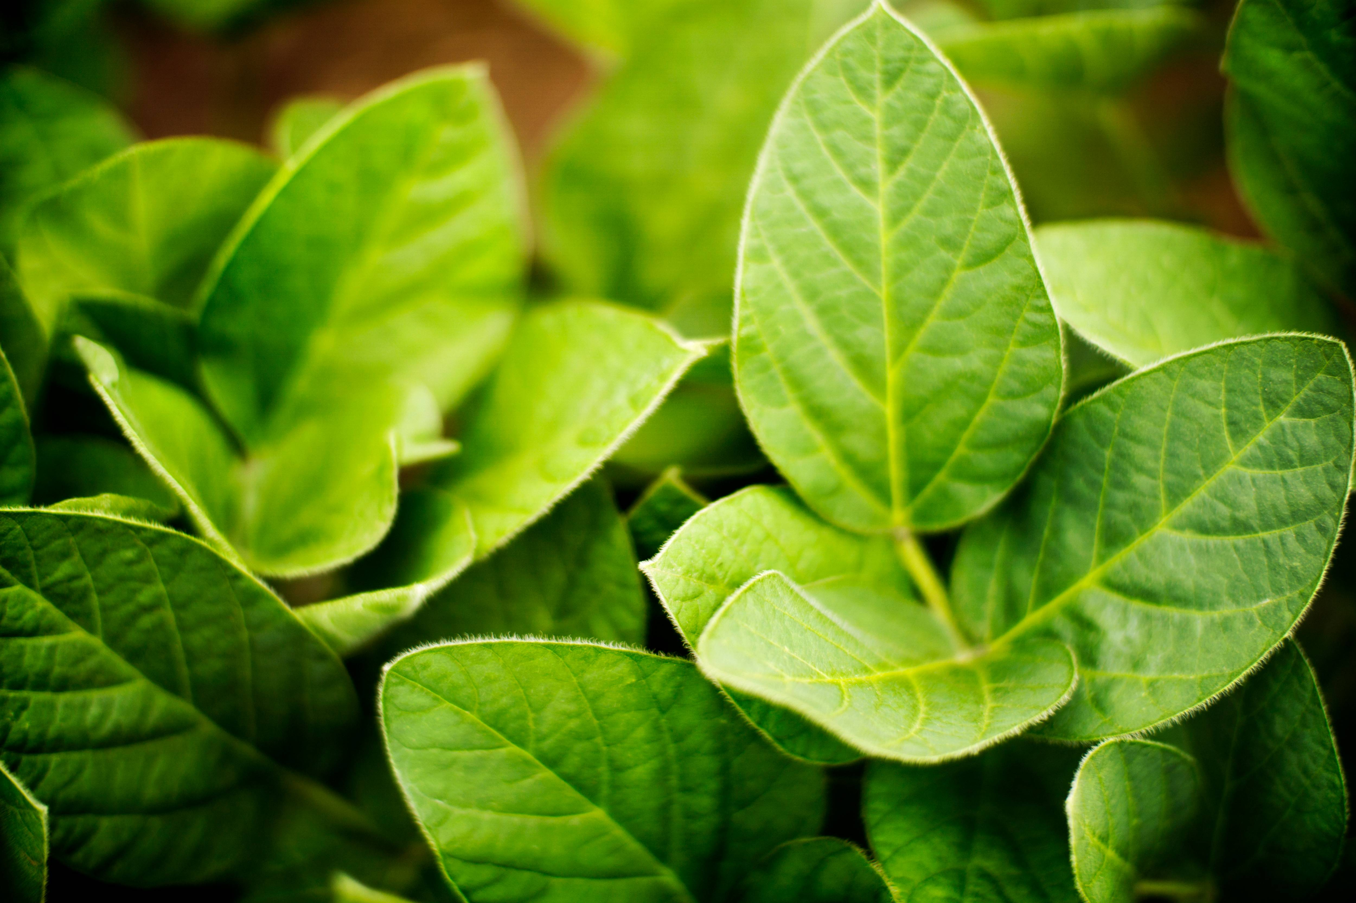




Who We Are
BIO Grains Trading AG is a family run Swiss trading company specializing in organic grains, oilseeds, oils, and press cakes. Since our founding, we have combined decades of experience in international organic commodity markets with trusted relationships across Europe and beyond.
Traceability
Reliability
Partnership
Quality
From field to end product
Promises kept, always
Eye-to-eye collaboration
Highest organic standards
2

Slide 3
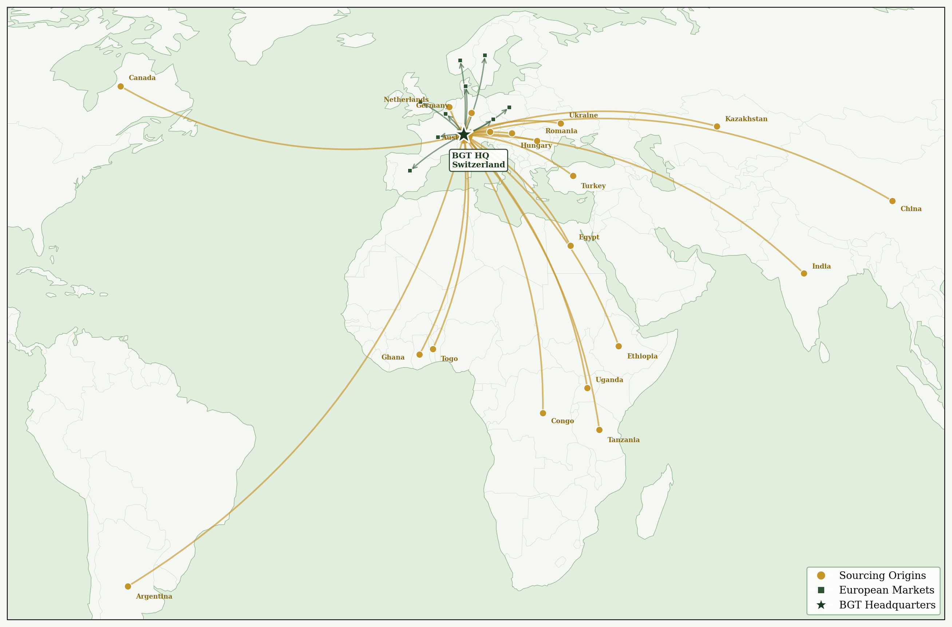
Our Global Reach
Sourcing organic commodities worldwide and distributing across Europe with Swiss reliability.
3

Slide 4
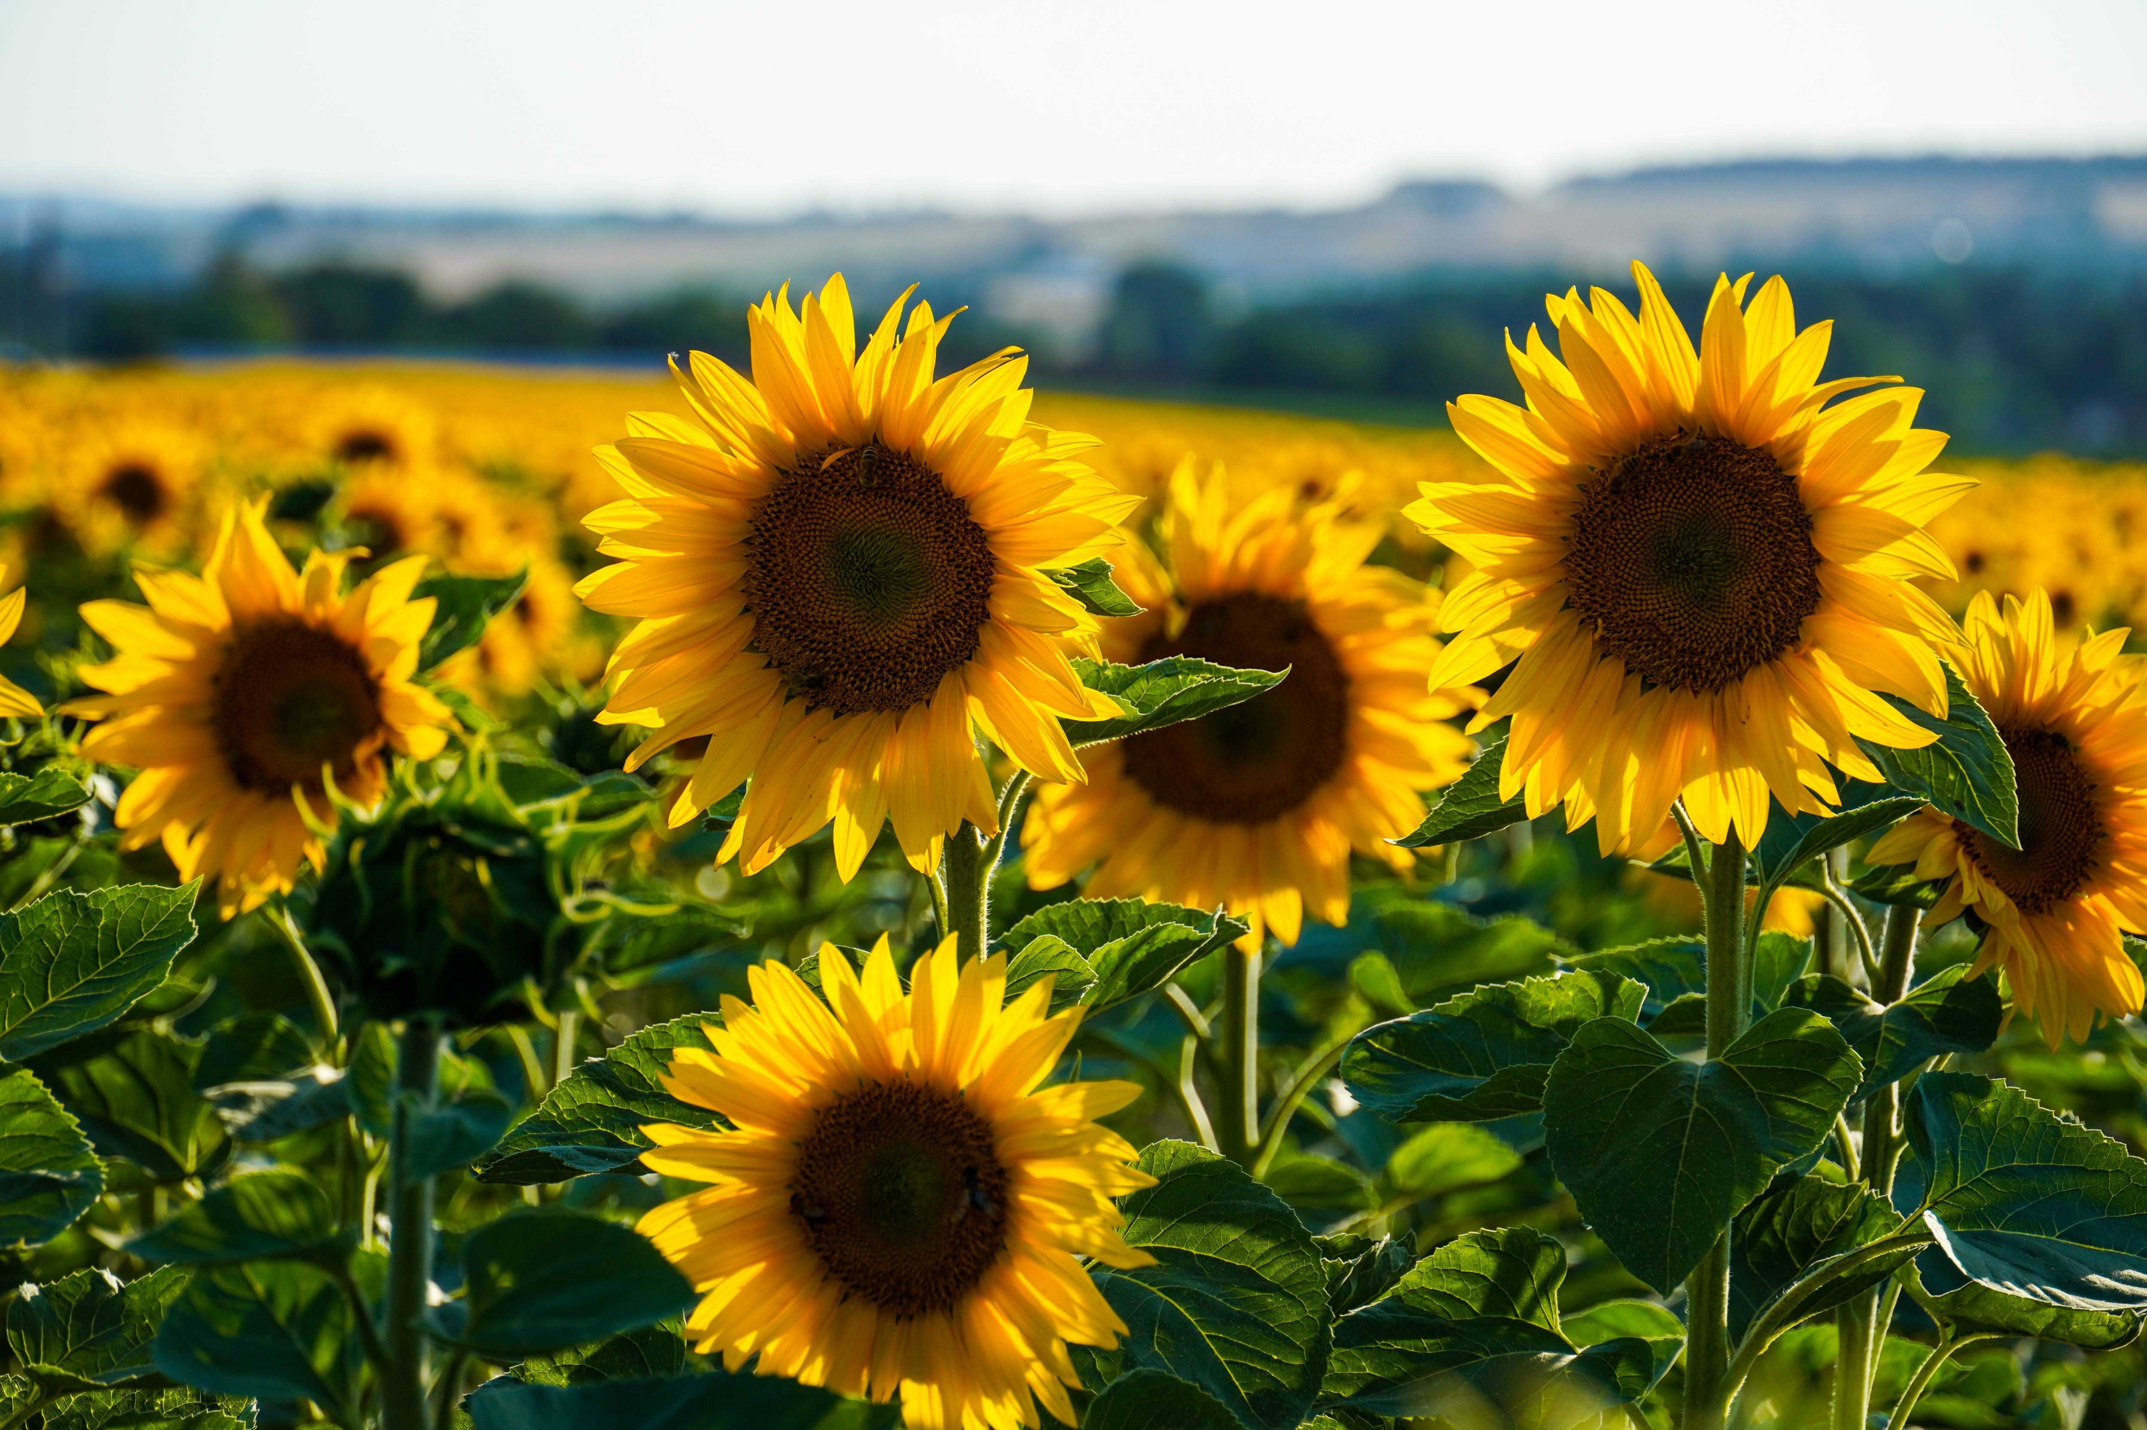
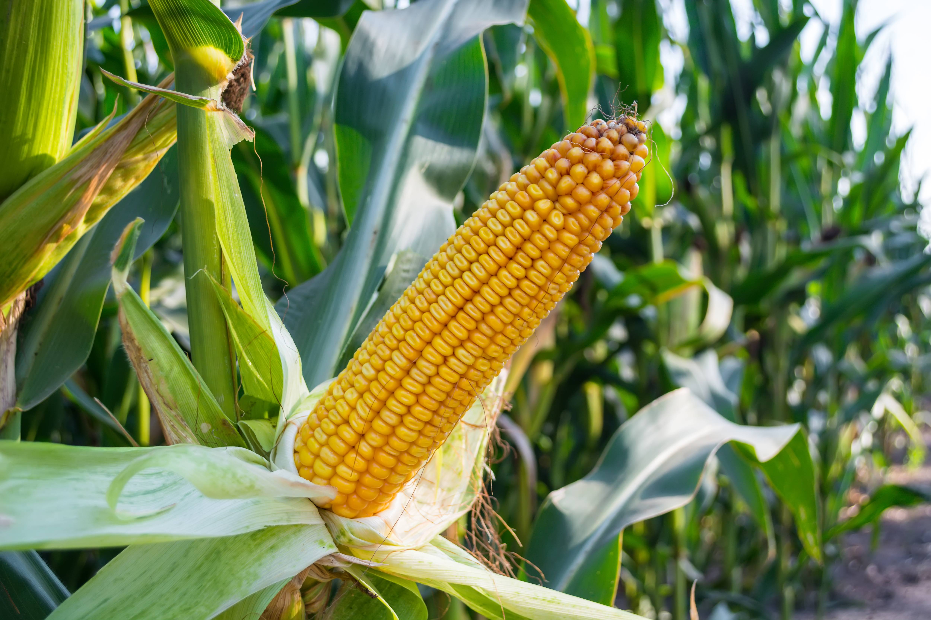
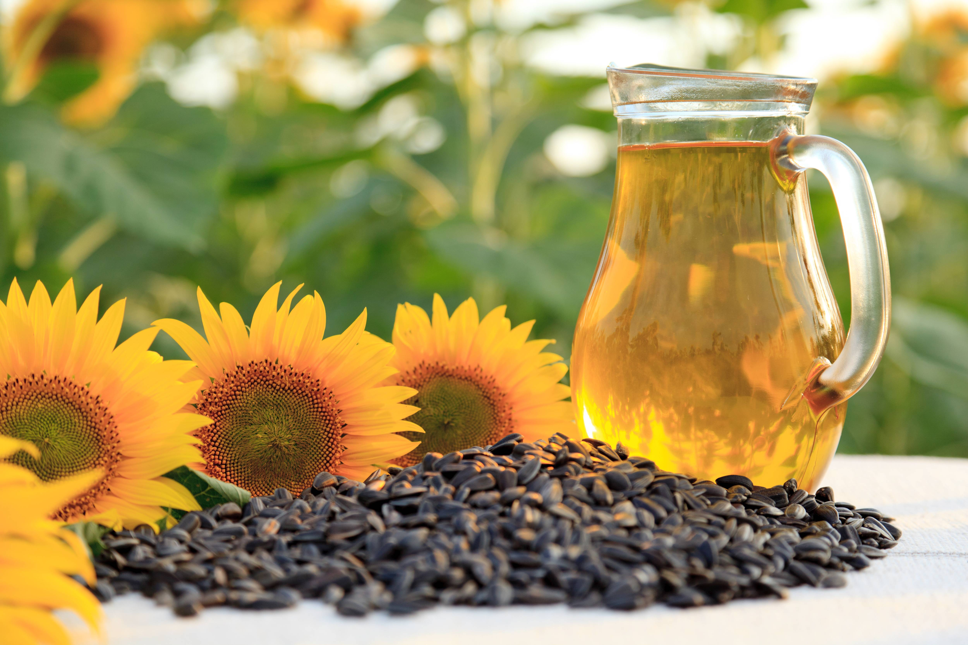
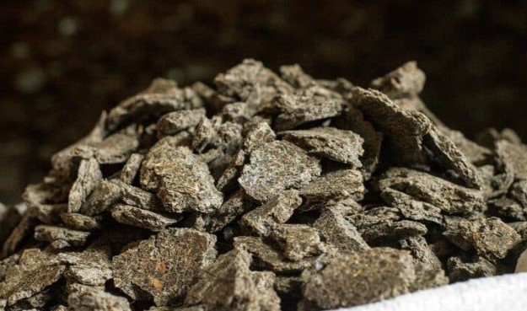
Our Product Portfolio
Certified organic products sourced globally, delivered with Swiss precision.
Bio Oilseeds
Bio Grains
Bio Oils
Bio Press Cakes
Flaxseed, Sunflower, Pumpkin, Sesame, Soybean, Rapeseed, Mustard
Wheat, Oat, Barley, Rye, Spelt, Corn, Millet, Buckwheat
Sunflower, Rapeseed, Soybean, Linseed | crude & refined
Sunflower, Soy, Rapeseed, Linseed cake
Website →
Website →
Website →
Website →
4

Slide 5

Bio Oilseeds
Certified organic oilseeds for food & feed applications, sourced from trusted growers worldwide.
Bio Brown & Golden Flaxseed
Bio Soybeans
Bio High Oleic Sunflower Seeds
Bio Hulled Sunflower Kernels
Bio Pumpkin Seeds
Bio Mustard Seeds
Bio Natural & Hulled Sesame
Bio Rapeseed
View on bgt.bio →
5

Slide 6
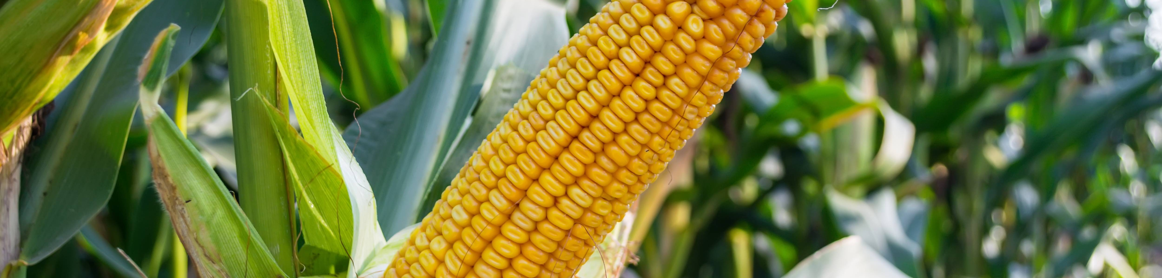
Bio Grains
A diverse range of organic cereals and pseudo-cereals, cultivated to the strictest bio standards.
Bio Wheat
Bio Spelt
Bio Oat
Bio Corn
Bio Barley
Bio Millet (hulled/unhulled)
Bio Rye
Bio Buckwheat
View on bgt.bio →
6

Slide 7
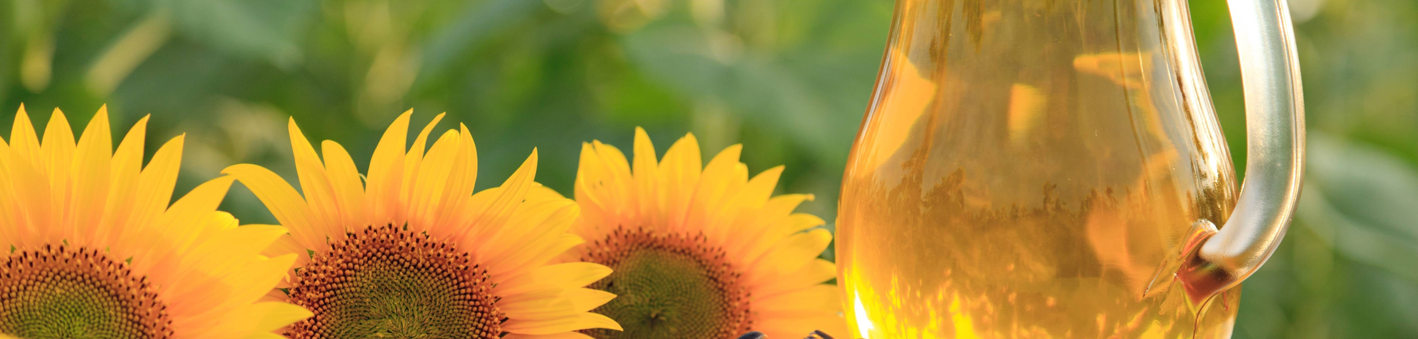
Bio Oils
Organic vegetable oils in crude and refined qualities for industrial and food-grade applications.
Bio Sunflower Oil crude/refined
Key Facts
Documented origin & traceability
Flexible delivery: tank, IBC, drums
Bio Suisse, EU Organic, GMP+
Direct B2B contact in Switzerland
Bio Rapeseed Oil crude/refined
Bio Soybean Oil crude/refined
Bio Linseed Oil crude/refined
View on bgt.bio →
7

Slide 8
Bio Press Cakes
High-quality organic press cakes from controlled processing — ideal for sustainable animal feed.
Bio Sunflower Cake LP/HP
Key Facts
For mills, feed producers & processors
Reliable availability & planning
Transparent documentation & QA
GMP+ FRA/FSA certified supply chain
Bio Soybean Cake
Bio Rapeseed Cake
Bio Linseed Cake
View on bgt.bio →
8

Slide 9






Our Services
Comprehensive solutions along the entire supply chain from field to delivery.
Contract Farming
Quality Assurance
Global Logistics
Secure premium raw materials with up to 2-year advance planning. Guaranteed availability and full traceability.
Continuous quality controls in accredited labs. Independent analysis ensures the highest standards.
Just-in-time deliveries worldwide with flexible transport solutions and reliable scheduling.
Strategic Storage
EU/CH Import Services
Flexible Packaging
Multiple locations with generous capacity and optimal conditions for product preservation.
Professional handling of third-country imports with full management and rapid customs clearance.
Truck, container, big bags, IBC, and custom sack sizes tailored to your needs.
9

Slide 10



Our Certifications
Certified quality you can trust meeting the highest organic and feed safety standards.
Bio Suisse
EU Organic
GMP+ FRA / FSA
Swiss organic label with strict guidelines exceeding EU standards. Recognized for premium quality.
Full compliance with EU organic regulation for production, processing, and trade. Bio Inspecta CH-BIO-006.
Feed Responsibility Assurance and Feed Safety Assurance certifications for the animal feed supply chain.
Download ↓
Download ↓
Download ↓
10

Slide 11
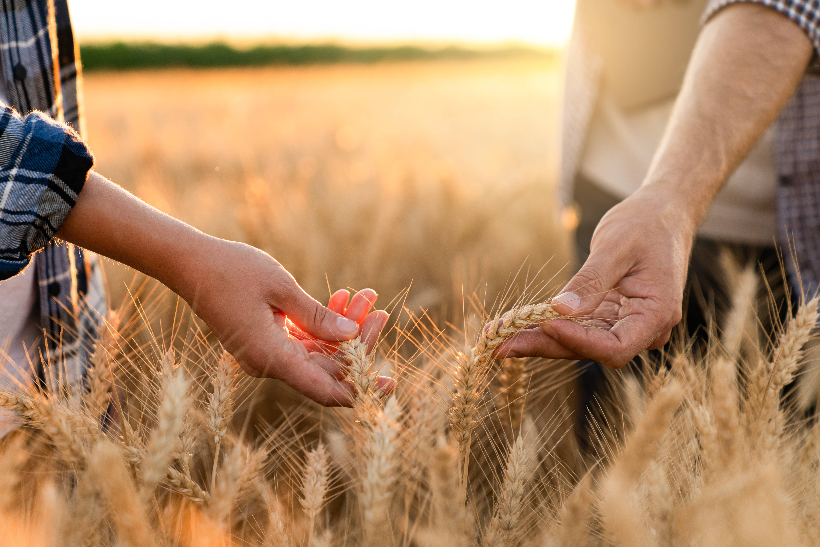




Let's Grow Together
We look forward to a partnership built on trust, quality, and mutual respect.
Buochserstrasse 26b, CH-6375 Beckenried
+41 41 530 00 10
info@bgt.bio | www.bgt.bio
Severin Spiess | Markus Schmid
BIO Grains Trading AG • Bio Suisse • EU Organic • GMP+

